Slide 1
Paper presentation - Ghost Peak: Practical Distance Reduction attacks against HRP UWB Ranging
Patrick Leu, Giovanni Camurati, Alexander Heinrich, Marc Roeschlin, Claudio Anliker, Matthias Hollick , Srdjan Capkun, and Jiska Classen
Aisha Kothare
Namruth Reddy
Notes:
High-Rate Pulse Repetition Frequency

Slide 2
Agenda
Abstract
Introduction
Paper background
Attack model and setup
Results
Strengths and Limitations
Conclusion
Notes:
Let's avoid this to save time

Slide 3
Abstract
Novel over the air attack on IEEE 802.15.4z HRP Ultra-Wide Band distance measurement systems.
Demonstrated on Apple U1, NXP and Qorvo chips
Attack works without prior knowledge of cryptographic material
Reductions from 12m to 0m with success probability of 4%
Inexpensive components to execute attack
Access control is a security vs usability tradeoff - can UWB HRP be used in security critical systems?
Notes:
High-Rate Pulse Repetition Frequency

Slide 4
Introduction
UWB chips are in wide variety of applications - smartphones, smart tags, cars (PKES), contact tracing and more to provided enhanced precision in measuring distance.
LRP vs HRP
Wireless signals can be used distance measurement but are susceptible to distance reduction and relay attacks.
Challenge of security vs performance(usability).
Key finding of the paper - IEEE 802.15.4z HRP mode has no specific mandate on how ranging is done and protected at endpoints.
Notes:
UWB signals are wireless signals that have a bandwidth in the range of hundred of Mhz to several Ghz HRP - high rate pulse repetition frequency - used in signals that need high data rate and and shorter range LRP - Low rate pulse repetition frequency - used in signals that need low data rate and longer range - applications include navigation and localization

Slide 5
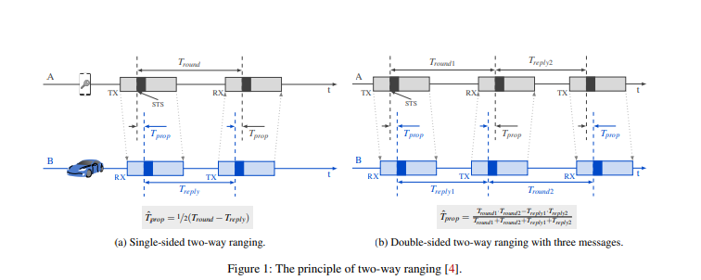
Background
Two way ranging
Notes:
Two way ranging to reduce the clock offset and get more accurate time measurements.

Slide 6
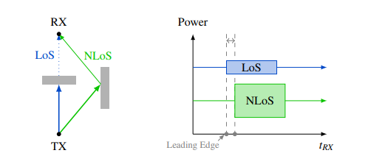
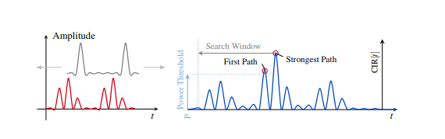
Background
Cross correlation and challenges such as NLoS, Channel distortion and reflections.
STS - scrambled timestamp sequence - AES 128 bits
Using cross correlation with a template to identify the correct signal and then use it to measure distance
Notes:
Cross correlation is used widely across the wireless signals to identity similar signals and to separate signals from noise. The value of cross correlation will be high between similar signals and usually low between signal and noise or other signals.
Cross correlation of received signals with an existing template to identify the time of arrival and eventually distance.

Slide 7
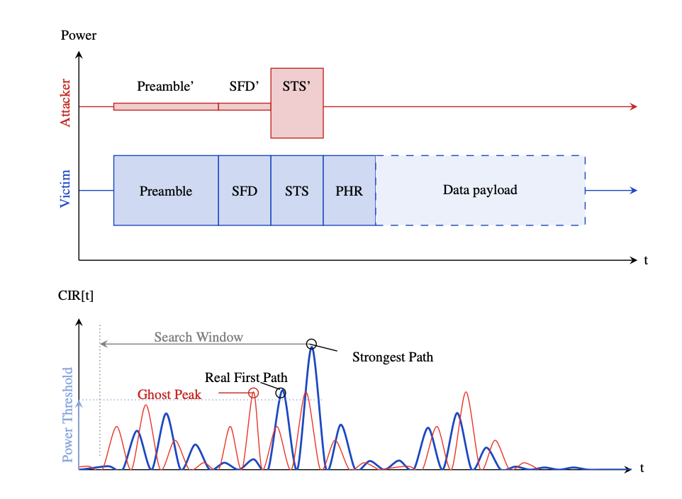
Attack Model - Assumptions
Black box attacker - no prior knowledge of shared secrets between victims
Can’t predict message field contents or STS
Can place its device in proximity of the victim - no physical access or tampering possible.
Receiver can work in NLoS conditions
Notes:
Receiver has a template of expected pulse form
The attacker transmits a carefully crafted packet (red), coarsely synchronized with the legitimate signal (blue), power sufficiently low to avoid jamming. The STS is secret and STS’ is randomly chosen by the attacker. Therefore, at the receiver the correlation peaks caused by the attacker (red) are lower than those of the strongest path (blue). How- ever, one of them (‘ghost peak’) is higher than the threshold for accepting peaks that correspond to legitimate paths, and it falls inside the back-search window. Therefore, it is mistakenly classified as an early path, shorter than the real one.
During transit, objects in the vicinity reflect the signal, which creates copies of the signal that are slightly delayed in time, as shown in Figure 2. Those copies are superimposed onto the original signal, causing constructive or destructive interference. Therefore, a momentary output of the correlation is non-conclusive, and instead, the Channel Impulse Response (CIR), i.e., the correlation output over time must be inspected.
Receiver uses a template of desired output required.
Channel Impulse Response (CIR), i.e., the correlation output over time, must be inspected. - multipath fading causes constructive and destructive interference.
The resulting CIR (in blue) exhibits multiple peaks. The highest peak does not necessarily correspond to the LoS path of the signal. Even before the strongest correlation value, any HRP receiver
must check for additional peaks within a specific time window. Such a peak might suggest an earlier but weaker copy of the signal, which belongs to a shorter path. By using this path as a
reference, the receiver can compute a more accurate ranging result. Details on how the time of arrival of the STS is deter- mined are not specified in the standard for HRP. At the time of writing, the exact procedure remains protected intellectual property for all commercially available HRP transceiver chips we have evaluated.

Slide 8
Attack Model
attacker device behaves like an UWB packet analyzer
packets crafted such that different packet fields are transmitted at different power levels.
Coarse tuning works
-A strong transmission power initially sends strong signal and then power is reduced till distance reduction start - see how fields of std packet affect reception
Notes:
Overshadow once sequence and timing identified

Slide 9
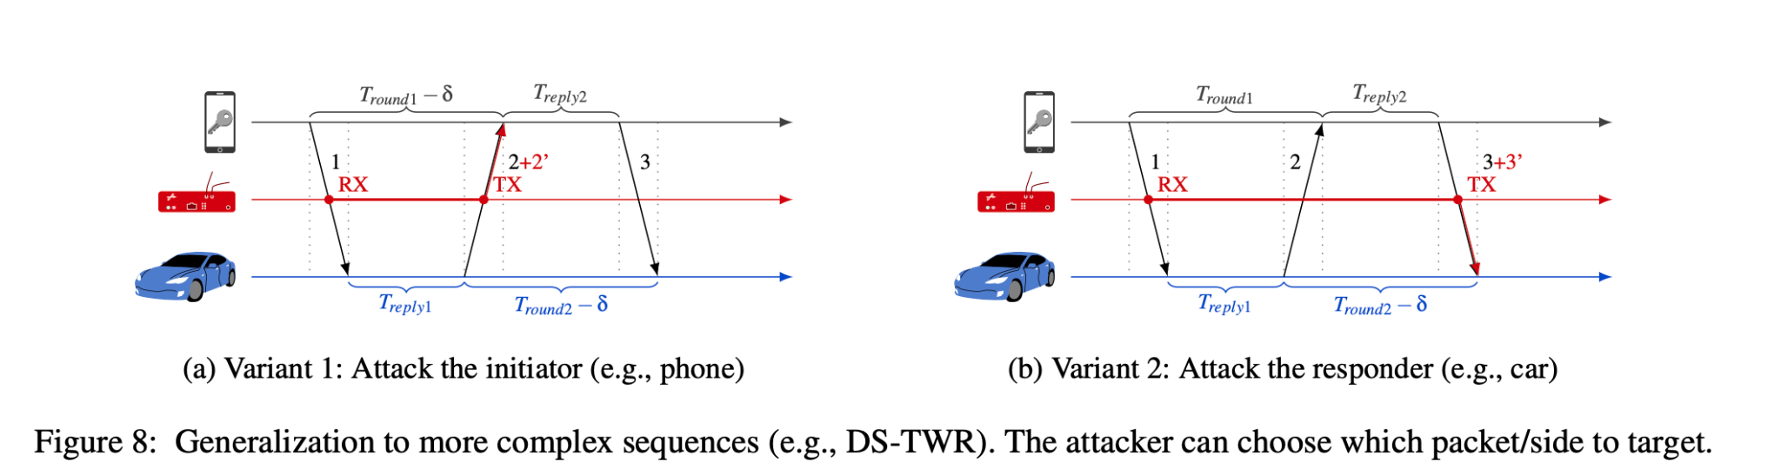
Attack Model
Instead of controlling distance reduction, focus is just on including the reduced distance.
Craft the timing, format, and power level of the attack signal. - different packets
Reactive transmission - allows targeting a specific packet in the ranging sequence, without affecting packets carrying data.
Can choose between attacking the 2nd / 3rd packet - depends on if you want to be closer to packet transmitted by responder or initiator.
Notes:
Attacking the second packet (attack responder) reduces both Tround1 (because the initiator receives the packet earlier) and Tround2 (because the initiator consequently replies earlier)
In practice, we have implemented the attack using a Qorvo DWM3000EVB [45], controlled by a Nordic Semiconductor nRF52 DK [37], for a total cost of around USD 65 only.

Slide 10
Attack Model
Attacker devices work as packet analyzer and then craft the packets based on required power level.
Craft the timing, format, and power level of the attack signal.
Coarse tuning is sufficient because of two way ranging.
Instead of controlling distance reduction, focus is just on including the reduced distance.
Notes:
Effect of distance on timings is significantly smaller than the synchronization accuracy.
Reactive transmission - allows targeting a specific packet in the ranging sequence, without affecting packets carrying data.
Can choose between attacking the 2nd / 3rd packet - depends on if you want to be closer to packet transmitted by responder or initiator.
Attacking the second packet (attack responder) reduces both Tround1 (because the initiator receives the packet earlier) and Tround2 (because the initiator consequently replies earlier)
In practice, we have implemented the attack using a Qorvo DWM3000EVB [45], controlled by a Nordic Semiconductor nRF52 DK [37], for a total cost of around USD 65 only.

Slide 11
Implementation
Wireshark dissector
Unencrypted parameters give reception and diagnostics
Parameters like STS length, packet structure can be adjusted until correct reception of full packet occurs.
Delay configured to be a multiple of reply time used by victims
Notes:
Wireshark dissector : is used to record timestamps and inspect parts of packets not encrypted - most UWB protocols are closed source.
Initial parameters like channel number lead to reception and diagnostic event like preamble quality, error codes.
Delay : so that attack signal is transmitted on top of packet 2 or 3.

Slide 12
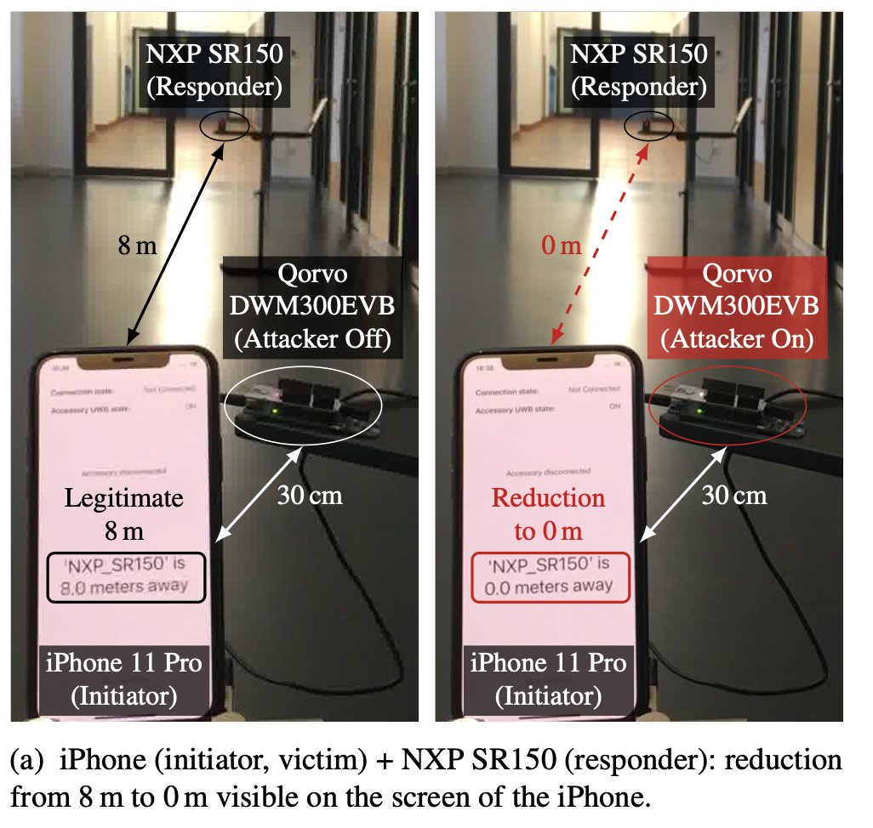
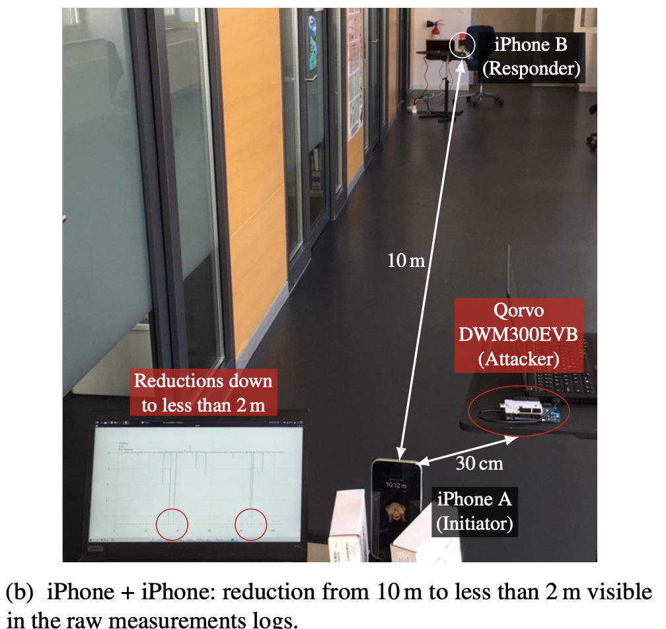
Setup
Notes:
Indoor LoS env - avoid measurement noise due to channel - could distort output
Performed on distances in a range of 5-15 m
Antenna facing each other
Places Qorvo in 30cm proximity to initiator&/ responder
Qorvo performs reactive attack - detect initial frame exchange and then overshadow preamble and STS or 1 or 2 frame.
The success rate, which is calculated as a rolling average over 300 measurements, is plotted in orange. Over the entire experiment, the rate of reductions was 4.08 %. The histogram on the left side reflects the distribution of the reduced distances reported in the experiment.
One of the main goals for UWB-based access control is to provide seamless access when the user is close, while turning on ranging only when necessary to save power.
One method to achieve this is to use Bluetooth Low Energy (BLE) to detect the presence of the device and, if the BLE Received Signal Strength Indicator (RSSI) is high enough, start UWB ranging, as done by Handoff music in the iPhone–HomePod scenario.
UWB key sol only need to determine if a distance is below or above a threshold - applications do not display detailed distance information in the user interface.
In the case of the Apple UWB implementation, the U1 chip reports the raw measurements to iOS drivers, which log them. Viewing these measurement logs requires the Location Services and AirTag debug profile, which can be installed on any iPhone without jailbreak [29]. Then, detailed measurement information appears in the logs, including the distance.

Slide 13
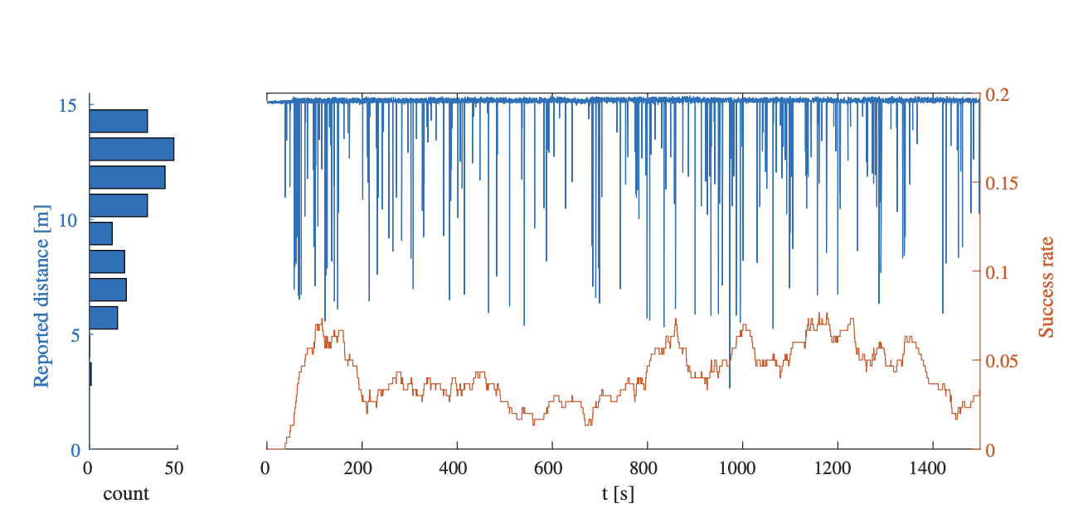
Results
Notes:
Attack success = the rate of distance measurements indicating a shorter distance than the baseline.
Distance reductions between 2 to 12 meters with success rates ranging from 2% to 4%.
The range of possible relative distance reductions does not depend on the actual distance between the devices and is bounded by 10 meters.
The attack can be successful in scenarios where a key is placed less than 14 meters away, and in configurations where only the responder is vulnerable, distance reductions are limited by approximately 5 meters.

Slide 14
Strengths and Limitations
Strengths | Limitations
Simple, practical and inexpensive hardware | Max distance reduction is limited. Incase of Apple U1 - 15m
Wide range of applications and different hardware from various vendors | Attacker cannot precisely control the distance
Black box attack without the knowledge of any cryptographic primitives | Security configurations of the chip are proprietary.
Notes:
A system designed to be operated at larger ranges would also require a larger backsearch window, resultiing in larger reductions, too. It is worth noting that the attacker is generally not interested in steering distance precisely.
Additional measures to detect outliers and experiences like unlocking cars etc require to be smooth.

Slide 15
Suggestions and countermeasures
Security should be part of the standard and not specific to vendors. Vendors can just concentrate on the implementation challenges and not security guarantees.
Just using AES to generate random key itself is not enough to make distance calculation secure.
Advanced statistics to check all the peaks independently - leads to higher complexity and maynot be suitable for battery powered devices

Slide 16
Conclusion
Chips across the vendors such as Apple, NXP and Qorvo are vulnerable to this attack.
Applications for UWB HRP are many - car doors, contact tracing, indoor localization, etc
Cryptographically high STS sequence does not necessarily guarantee elimination of distance reduction attacks.

Slide 17
Questions?

